Slide 1
Router and Routing Basics

Slide 2
Routing Protocols and Concepts
Routing and packet forwarding
Static routing
Dynamic routing protocols
Distance vector routing protocols
Link-state routing protocols

Slide 3
Routers
Special type of computer
Connect and allow communication between two networks
Determine the best path through the network
Configuration files to control the traffic
Generally have two connection types:
  WAN connection (connection to ISP)
  LAN connection

Slide 4
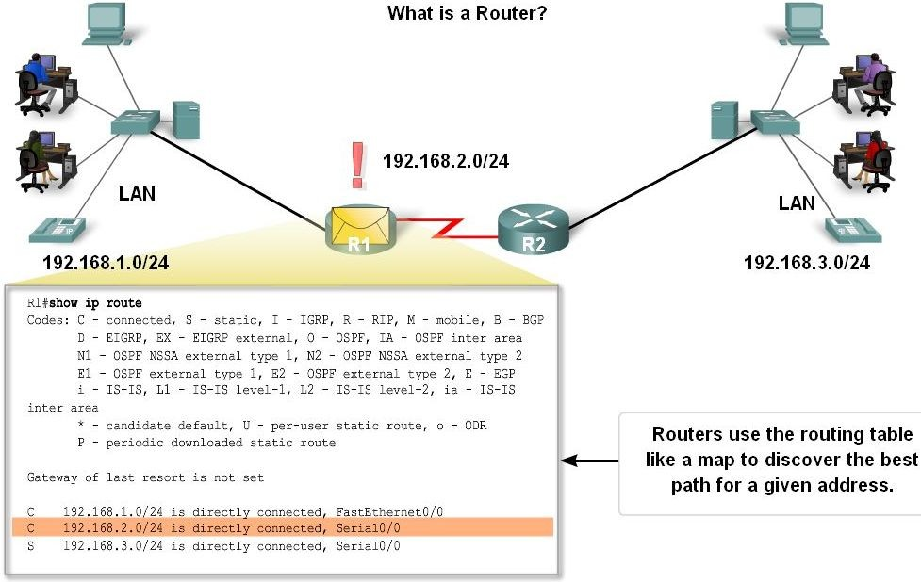
Routers
Data is sent in form of packets between two end devices
Routers are used to direct packets to its destination
Routers examine a packets destination IP address and determine the best path by using a routing table

Slide 5
Cisco IOS Software
Operating system in all of the Cisco routers or switches, which provides the following network services:
Basic routing and switching functions
Reliable and secure access to networked resources
Network scalability

Slide 6
Router components
CPU
  Executes operation systems instructions
RAM
  Stores instructions and data needed for CPU
ROM
  Boot instructions, scaled-down vers. of IOS
Flash
  Stores IOS, copied into RAM during bootup proc.
NVRAM
  Startup configuration file

Slide 7
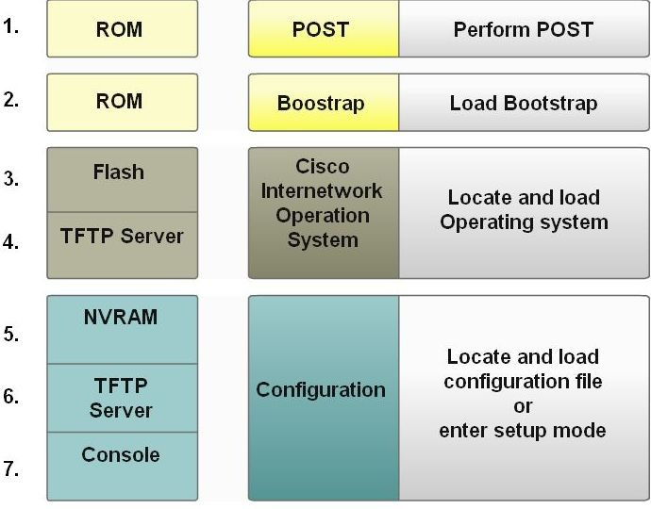
Router Boot-up process
Major phases to the router boot-up process
  Test router hardware
    Power-On Self Test (POST)
    Execute bootstrap loader
  Locate & load Cisco IOS software
    -Locate IOS
    -Load IOS
  Locate & load startup configuration file or enter setup mode
    -Bootstrap program looks for configuration file

Slide 8
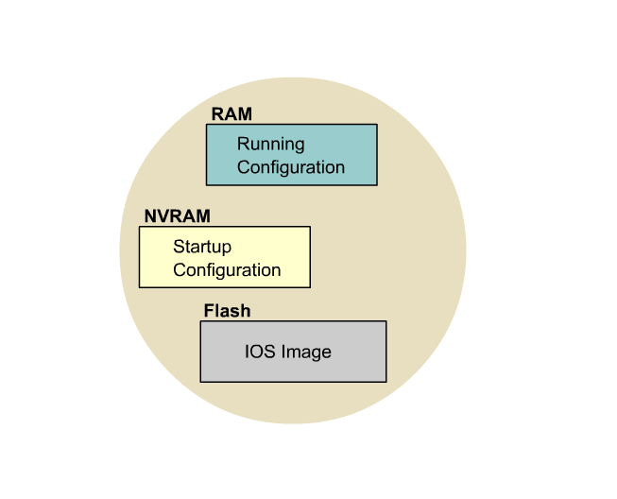
IOS File System Overview

Slide 9
Router interfaces
Interface: a physical connector on the router, main purpose to receive and forward packets
Interfaces connects to various types of networks, and different types of media and connectors are required
Each interface connects to a separate network

Slide 10
Router interfaces
LAN interfaces
  Ethernet, fastEthernet
  Connects the router to a LAN
WAN interfaces
  Serial, ISDN, Frame Relay
  Connects the router to external networks, interconnect LANs

Slide 11
Routing
Process to forward packets to destination networks
Layer 3 device
Examines destination IP address (Layer 3)
Routing table is used to find best path to destination

Slide 12
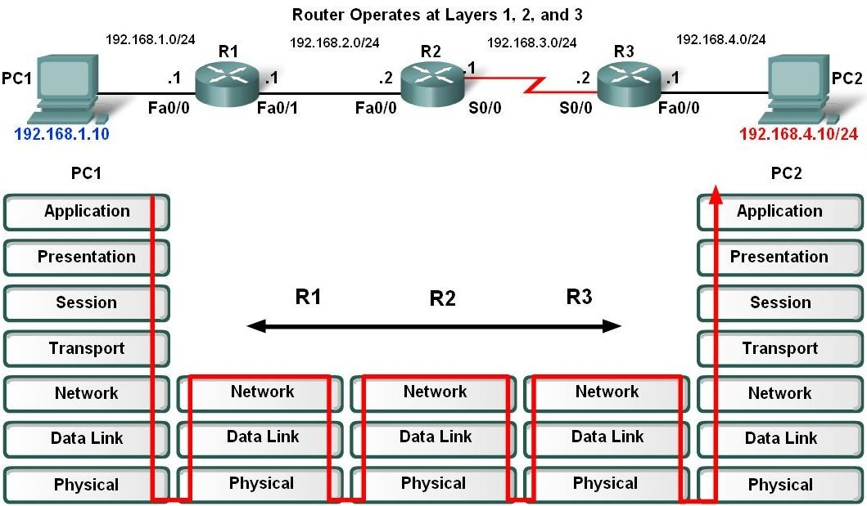
Routing
Forwarding decisions based on Layer 3
Operates at Layer 1, 2 and 3

Slide 13
Routing Table
Data file in RAM
Stores information about directly connected and remote networks
Contains network/next hop associations
Directly connected networks
Remote networks
  Static routes (manually configured)
  Dynamic routing protocols (learned from other routers)

Slide 14
Static Routing
Configured manually
Specifies network address and subnet mask of remote network, and IP address of next hop router or exit interface
Use static routes when:
  Network only consists of few routers
  Network is connected to Internet only through one ISP

Slide 15
Static Routing
Advantages:
Minimal CPU processing
Easy to configure
Easier for administrator to understand

Slide 16
Static Routing
Disadvantages:
Configuration and maintenance is time- consuming
Does not scale well with growing networks
Requires complete knowledge of the whole network for proper implementation

Slide 17
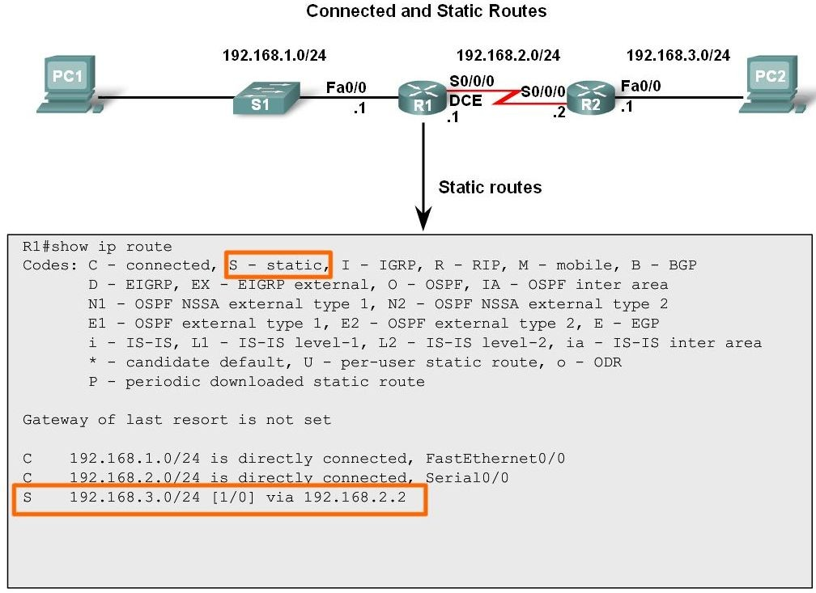
Static Routing

Slide 18
Dynamic routing
Added to routing table by using a dynamic routing protocol
Used by routers to share information about the reachability and status of remote networks
Perform several activities:
  Network discovery
  Updating and maintaining routing tables

Slide 19
Dynamic routing
Advantages:
Less administrative overhead when adding or deleting a network
Protocols automatically react to the topology changes
More scalable

Slide 20
Dynamic Routing
Disadvantages:
Router resources are used (CPU cycles, memory and link bandwidth)
More administrator knowledge is required for configuration, verification and troubleshooting

Slide 21
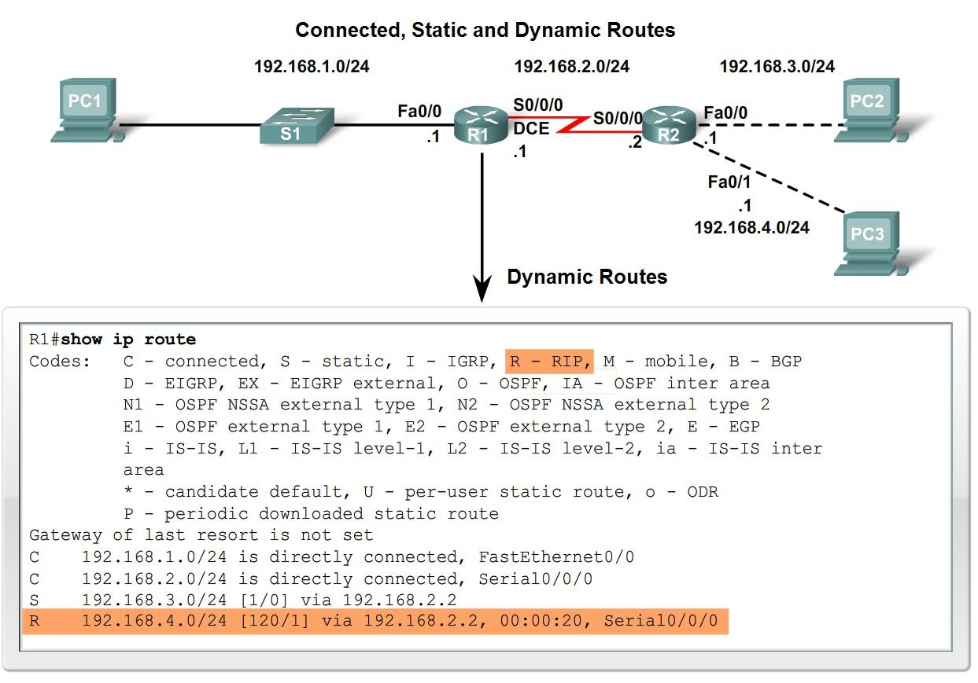
Dynamic Routing

Slide 22
Best Path and Metric
Multiple path to same destination
Best path is selected by the routing protocol, based on a specific value (metric)
Each protocol uses its own rules and metrics to build and update routing tables
Metric is used to measure the distance to the destination network
Lowest metric = best path, placed in routing table

Slide 23
Metrics
Hop cont: counts the number of routers a packet must traverse
Bandwidth: preferring the path with highest bandwidth
Load: traffic utilization on a link
Delay: time for a packet to traverse a path
Reliability: probability of a link failure
Cost: determined by IOS or administrator to indicate preference for a route

Slide 24
Path Determination
The process of how the router determines which path to use when forwarding a packet
Directly connected
  Forwarded directly to the destination
Remote network
  Forwarded to another router
No route determined
  Packet discarded, ICMP unreachable sent

Slide 25
Switching Function
Process used by a router to accept a packet on one interface and forward it out another interface
Decapsulate the Layer 3 packet by removing Layer 2 frame header and trailer
Examines destination IP address of the packet to find best path in routing table
Encapsulate Layer 3 packet into a new Layer 2 frame and forwards on correct interface

Slide 26
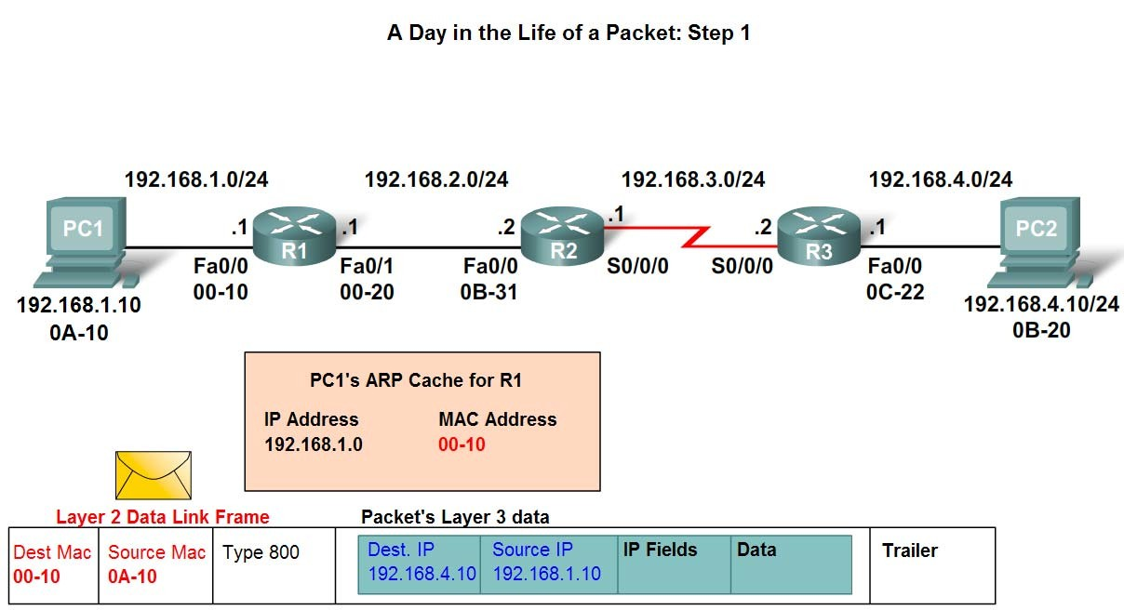
Example
PC 1 will send a packet to PC 2

Slide 27
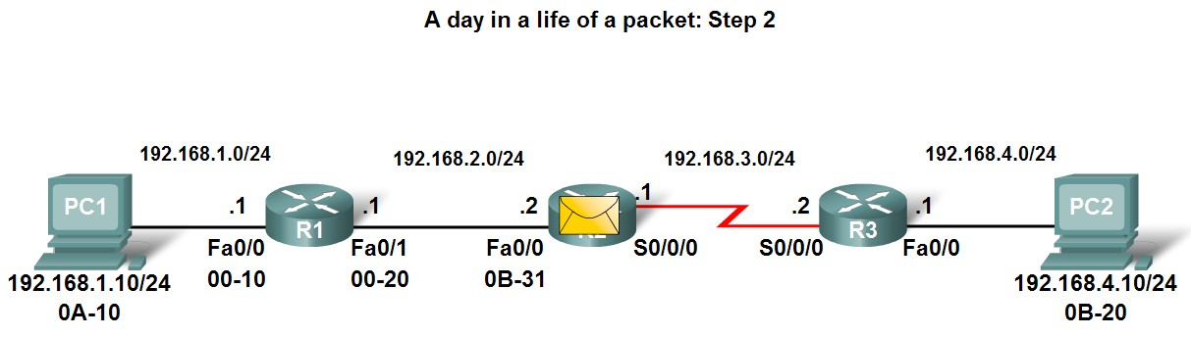
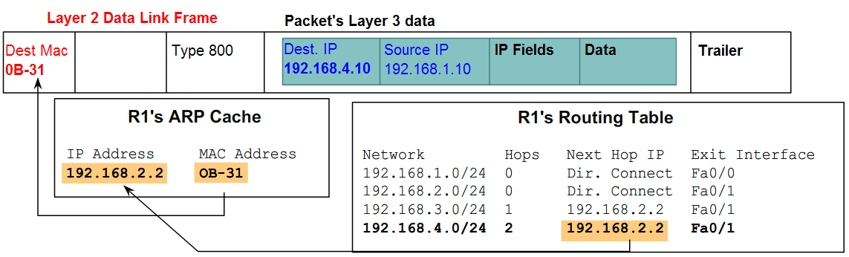
Example cont.

Slide 28
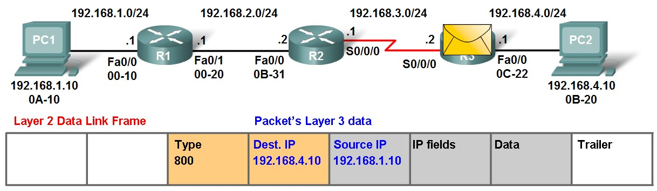
Example cont.

Slide 29
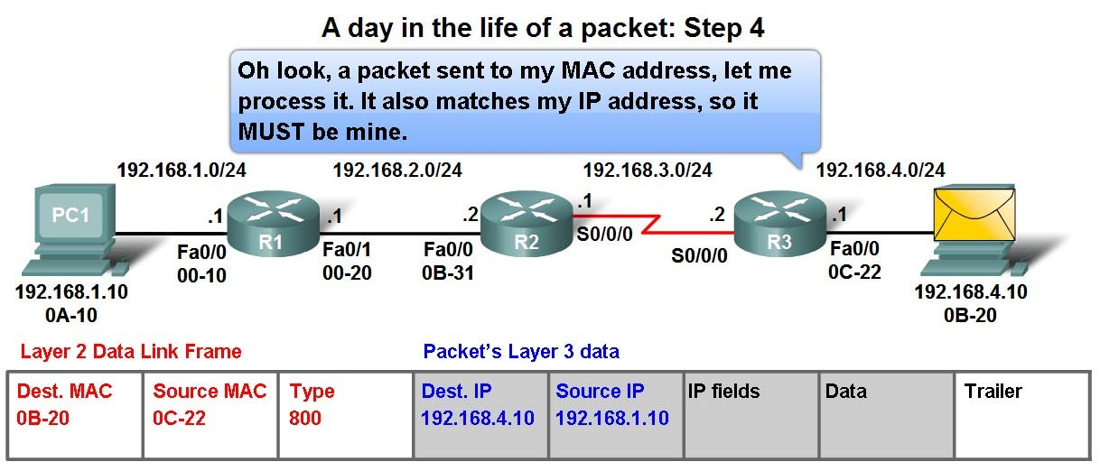
Example cont.

Slide 30
IP Routing protocol
RIP (Routing Information Protocol)
IGRP (Interior Gateway Routing Protocol)
EIGRP (Enhanced IGRP)
OSPF (Open Shortest Path First)
IS-IS (Intermediate System-to-Intermediate System)
BGP (Border Gateway Protocol)

Slide 31
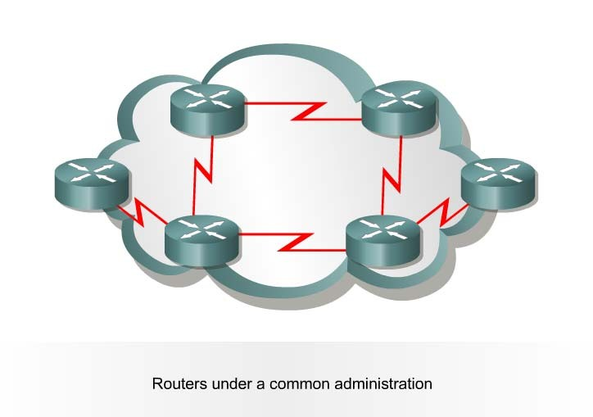
Autonomous System (AS)
002-1 © 2002, Svenska-CNAP / Halmstad University.
Collection of networks/routers
Share a common routing strategy
Viewed as a single entity from the outside world
Version 2
32

Slide 32
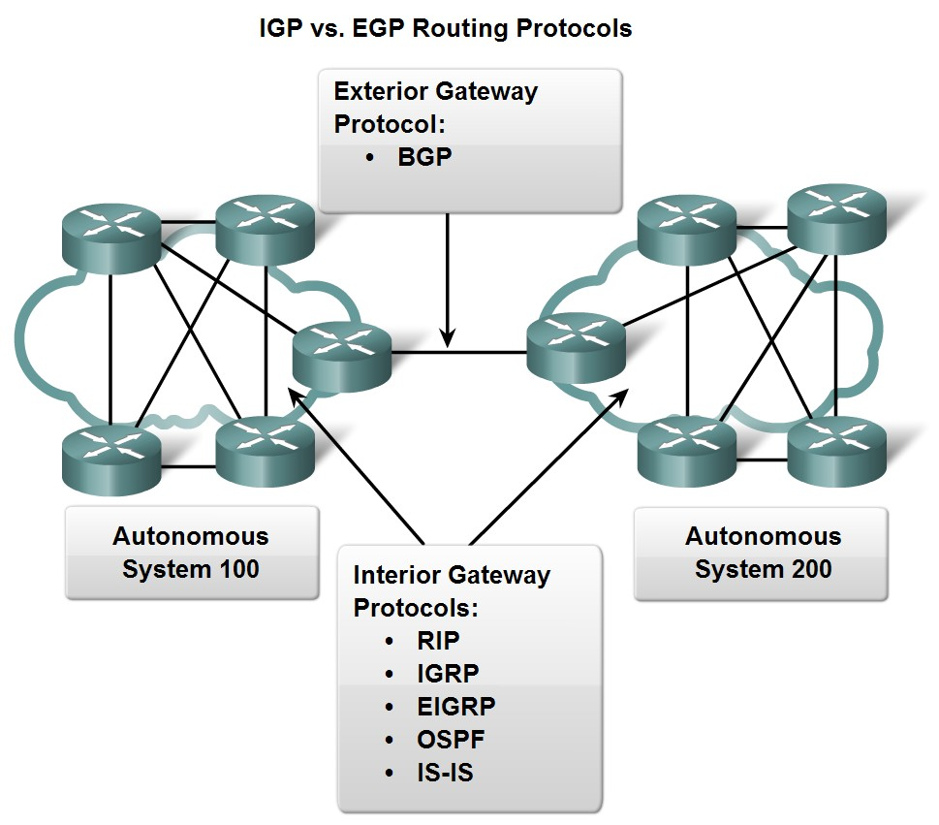
Routing Protocols
Routing protocols can be classified into different groups according to their characteristics
  Interior Gateway Protocols (IGP)
  Exterior Gateway Protocols (EGP)
32

Slide 33
IGP Routing Protocols
Two classes of routing protocols:
Distance vector
  Determines the direction and distance to any link in the internetwork
Link-state
  Recreates the exact topology of the entire internetwork
33

Slide 34
Distance Vector Routing Protocol
Periodic updates
Slow convergence
Routing table from directly connected neighbor routers
Add distances before passing it to other neighbors
Distance is defined in terms of a metric, such as hop count
34

Slide 35
Link-state Routing Protocol
Complex database of topology information
Knowledge of the entire network
Uses SPF to calculate the best path
Updates when changes in the topology occurs
Fast Convergence
More memory and processor overhead
35

Slide 36
Classful Routing Protocols
Do not send subnet mask information in routing updates
Do not support variable length subnet masks (VLSM) and discontiguous networks
36

Slide 37
Classless Routing Protocols
Include the subnet mask in routing updates
Supports both VLSM and discontiguous networks
Required in most networks today
37

Slide 38
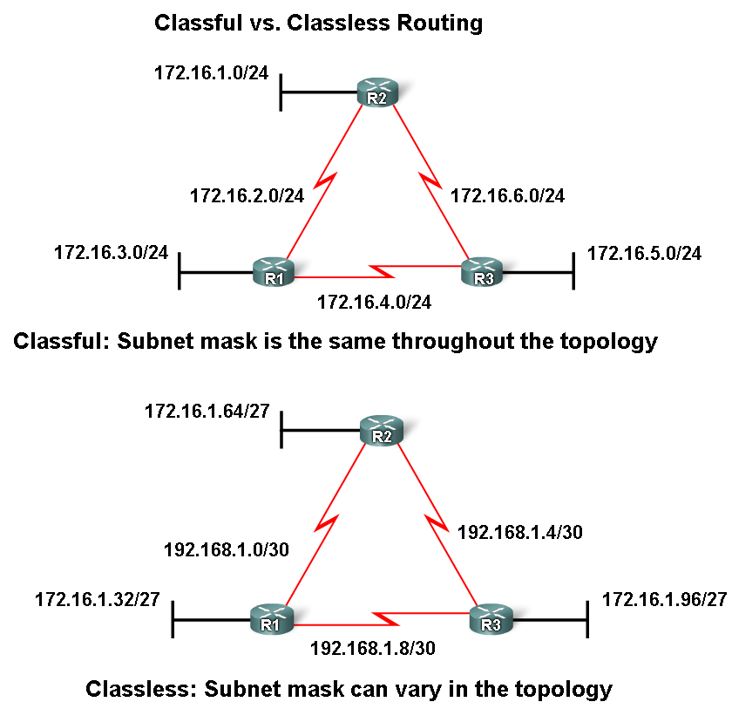
Classful vs. Classless Routing
38

Slide 39
Convergence
When all routers routing tables are at a state of consistency
All routers have complete and accurate information about the network
Convergence time is the time it takes routers to share information, calculate best paths, and update their routing tables
A network is not completely operable until the network has converged. Short convergence times are required
39

Slide 40
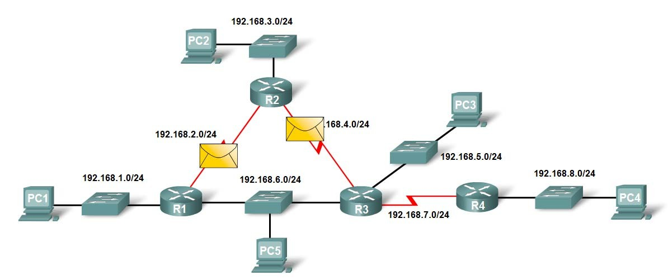
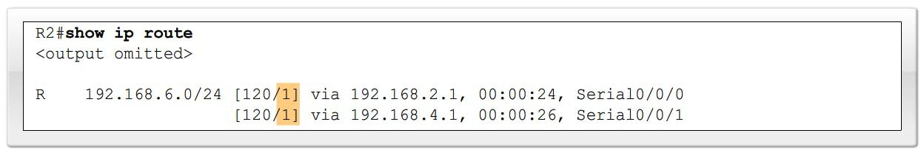
Load Balancing
The ability for a router to distribute packets among multiple same cost paths
40

Slide 41
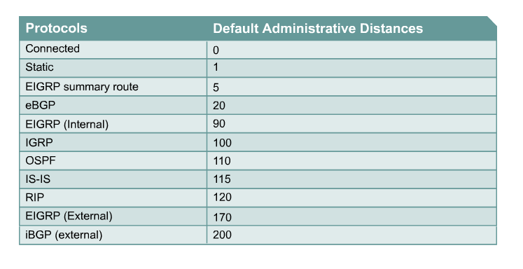
Administrative Distance
Administrative distance is used to determine the best path to a particular destination, when the same path is learned from two or more different routing sources
Measures the trustworthiness of a routing source
Lowest AD is inserted in the routing table
41

Slide 42
Default Routes
Used when the router is unable to match a destination network
Do not have to maintain a routing table entry for every Internet network
Statically entered by an administrator
– ip route 0.0.0.0 0.0.0.0
Dynamically learned using a routing protocol
– ip default-network
42

